Slide 1
Analysis of Large Graphs
Community Finding and Graph Partitioning

Slide 2
Overview
Introduction & Motivation
Graph cut criterion
Min-cut
Normalized-cut
Non-overlapping community detection
Spectral clustering

Slide 3
Introduction
What is the graph?
Definition
An ordered pair G = (V, E)
A set V of vertices
A set E of edges
A line of connection between two vertices
2-elements subsets of V
Types
Undirected graph, directed graph, mixed graph, multigraph, weighted graph and so on

Slide 4
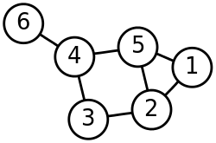
Introduction
Undirected graph
Edges have no orientation
Edge (x,y) = Edge (y,x)
The maximum number of edges : n(n-1)/2
All pair of vertices are connected to each other
Undirected graph G = (V, E)
V : {1,2,3,4,5,6}
E : {E(1,2), E(2,3), E(1,5), E(2,5), E(4,5)
E(3,4), E(4,6)}

Slide 5
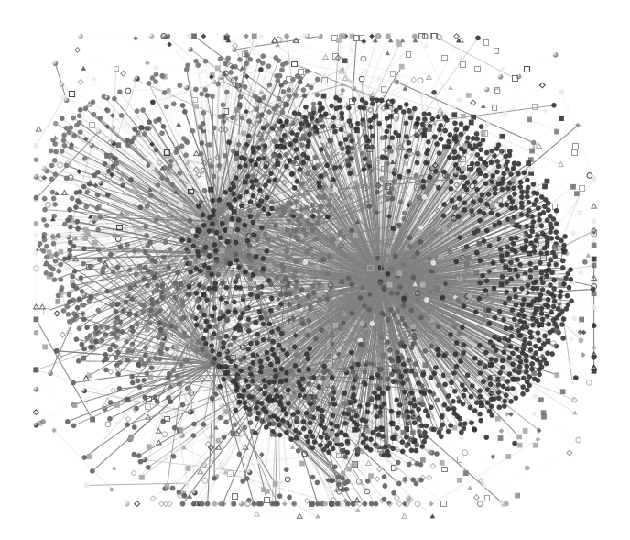
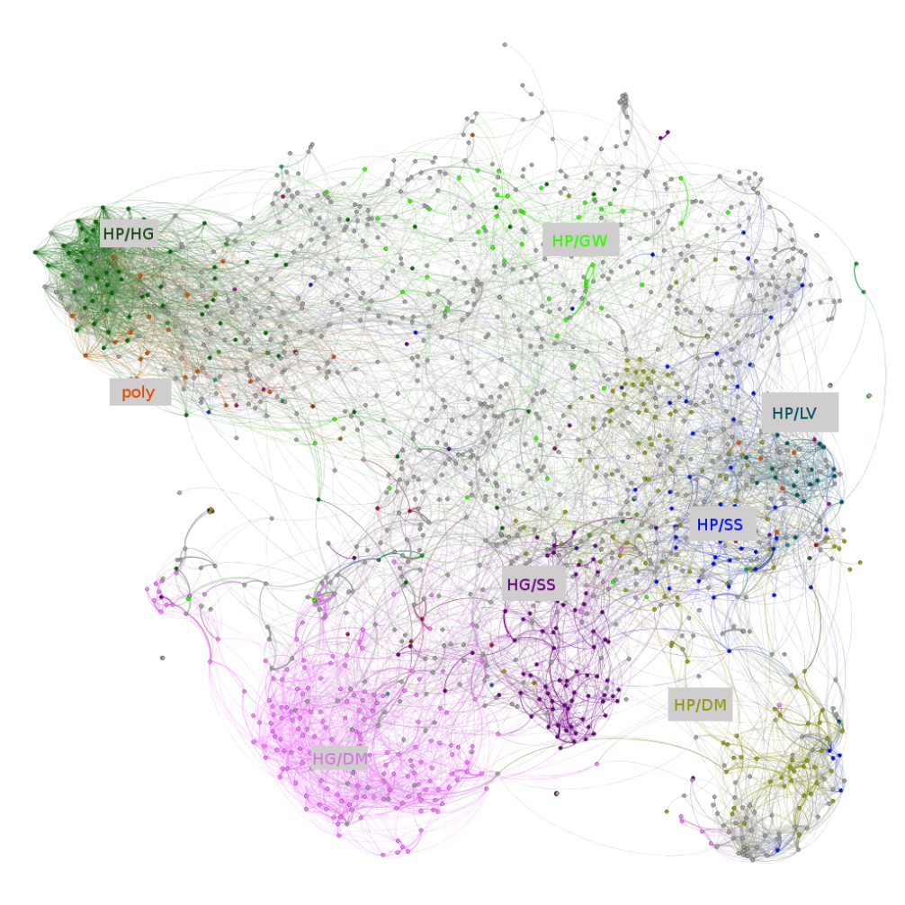
Introduction
The undirected large graph
E.g) Social graph Graph of Harry potter fanfiction
A sampled user email-connectivity graph : http://research.microsoft.com/en-us/projects/S-GPS/
Adapted from http://colah.github.io/posts/2014-07-FFN-Graphs-Vis/

Slide 6

Introduction
The undirected large graph
E.g) Social graph Graph of Harry potter fanfiction
Q : What do these large graphs present?
A sampled user email-connectivity graph : http://research.microsoft.com/en-us/projects/S-GPS/
Adapted from http://colah.github.io/posts/2014-07-FFN-Graphs-Vis/

Slide 7
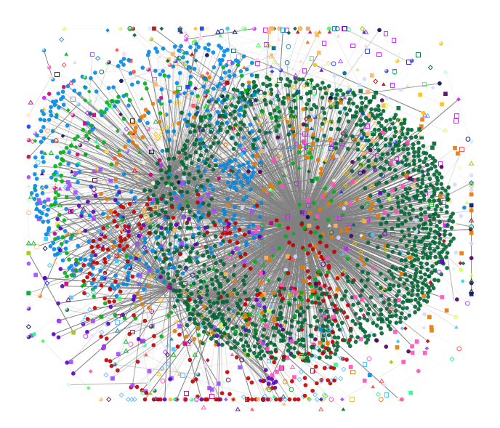
Motivation
Social graph : How can you feel?
VS
A sampled user email-connectivity graph : http://research.microsoft.com/en-us/projects/S-GPS/

Slide 8

Motivation
Graph of Harry potter fanfiction : How can you feel?
VS
Adapted from http://colah.github.io/posts/2014-07-FFN-Graphs-Vis/

Slide 9
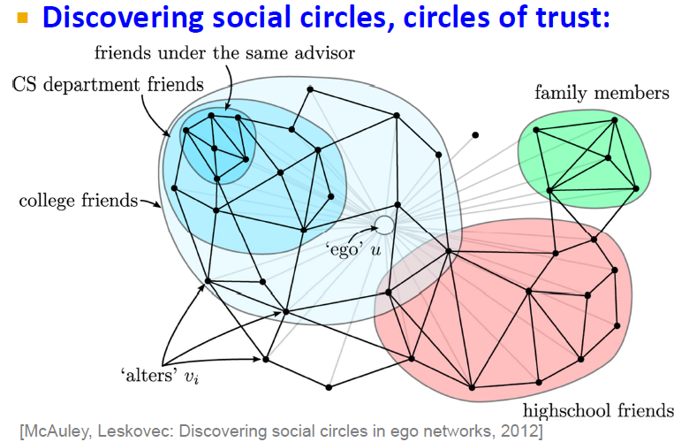
Motivation
If we can partition, we can use it for analysis of graph as below

Slide 10
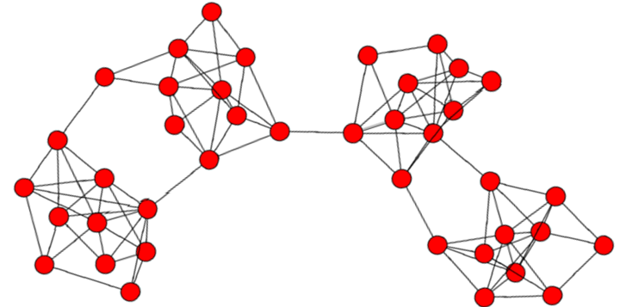
Motivation
Graph partition & community detection

Slide 11
Motivation
Graph partition & community detection

Slide 12
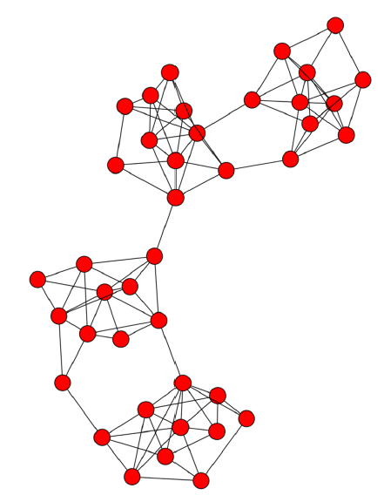
Motivation
Graph partition & community detection
Partition
Community

Slide 13

Motivation
Graph partition & community detection
Partition
Community
Q : How can we find the partitions?

Slide 14
Criterion : Graph partitioning
Minimum-cut
Normalized-cut
Notes:
Machine learning algorithms can be classified according to the nature of data to be learned into either offline or online learning

Slide 15
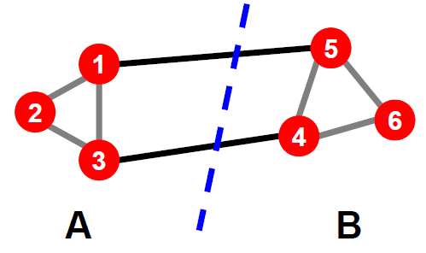
Criterion : Basic principle
Graph partitioning : A & B
A Basic principle for graph partitioning
Minimize the number of between-group connections
Maximize the number of within-group connections

Slide 16
Criterion : Min-cut VS N-cut
A Basic principle for graph partitioning
Minimize the number of between-group connections
Maximize the number of within-group connections
Minimum-Cut vs Normalized-Cut
 | Min-cut | N-cut
Minimize: between group connections
Maximize : within-group connections | X

Slide 17
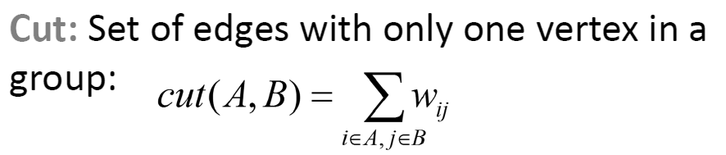
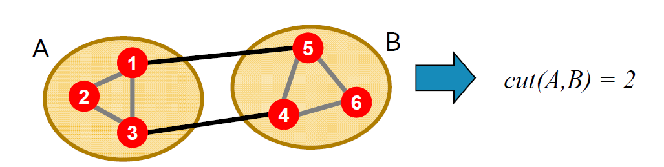
Mathematical expression : Cut (A,B)
For considering between-group

Slide 18
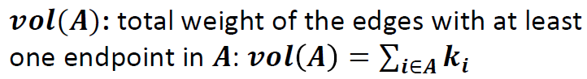
Mathematical expression : Vol (A)
For considering within-group
vol (A) = 5
vol (B) = 5

Slide 19
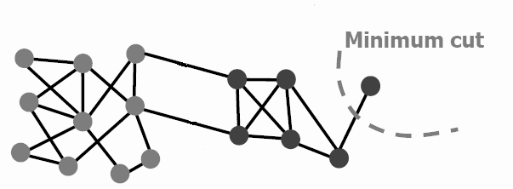
Criterion : Min-cut
Minimize the number of between-group connections
minA,B cut(A,B)
A
B
Cut(A,B) = 1 -> Minimum value

Slide 20
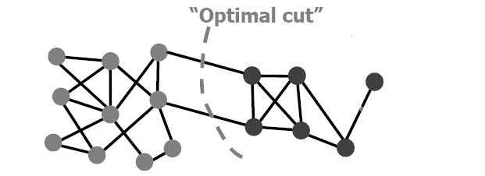
Criterion : Min-cut
A
B
Cut(A,B) = 1
A
But, it looks more balanced…
How?
B

Slide 21
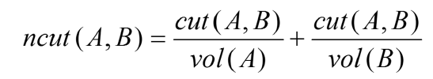
Criterion : N-cut
Minimize the number of between-group connections
Maximize the number of within-group connections
If we define ncut(A,B) as below,
-> The minimum value of ncut(A,B) will produce more balanced partitions because it consider both principles

Slide 22
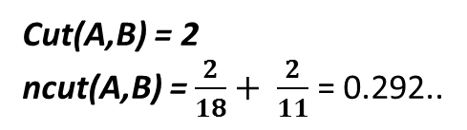
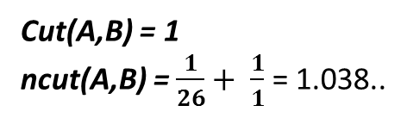
Methodology
A
B
Cut(A,B) = 1
ncut(A,B) = $\frac{1}{26}+ \frac{1}{1}$ = 1.038..
VS
A
B
Cut(A,B) = 2
ncut(A,B) = $\frac{2}{18}+ \frac{2}{11}$ = 0.292..

Slide 23
Non-overlapping community detection:
Spectral Clustering
Notes:
An important aspect of social networks is that they contain communities of entities that are connected by many edges. These typically corresponds to groups of friends at school or groups of researchers interested in the same topic. So we shall consider clustering of the graph as a way to identify communities. In this presentation, we will consider both cases, when an entity (individual) belongs only to one community, which implies that communities are disjoint and is called Non-overlapping communities. The other case in which the entity belongs to more than community, which implies that the entity is member of more communities in common, and is called overlapping communities. Starting here the discussion about clustering of non-overlapping communities.
In the literature of clustering analysis, there are a lot of data clustering algorithms. However, most of them are generally unsuitable for the problem of clustering social network graphs. Examples of these clustering algorithms are k-means and hierarchal clustering. So since there are problems with standard clustering algorithms, several specialized clustering algorithms have been developed to find communities in the social networks.
So we will discuss here two approaches for Non-overlapping community detection:
The first one that based on matrix theory, which is called Spectral graph clustering or partitioning. The other one that based on machine learning, which is called Deep GraphEncoder, that is also similar to spectral clustering.
These algorithms essentially based on finding the edges that are least likely to be inside a community. In other words, spilt the graph into two pieces in such way that each of two piece has lots of connection between the member of each piece and few connection crossing the two pieces. As an example …

Slide 24
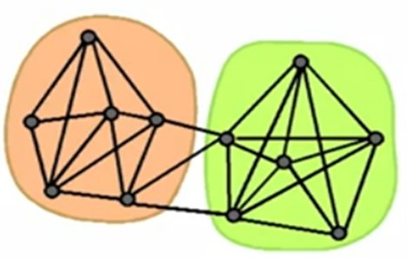
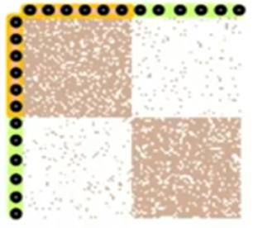
Finding Clusters
How to identify such structure?
How to spilt the graph into two pieces?
Nodes
Nodes
Network
Adjacency Matrix

Slide 25
Spectral Clustering Algorithm
Three basic stages:
1) Pre-processing
Construct a matrix representation of the graph
2) Decomposition
Compute eigenvalues and eigenvectors of the matrix
Focus is about and it corresponding .
3) Grouping
Assign points to two or more clusters, based on the new representation

Slide 26
Matrix Representations
Adjacency matrix (A):
n× n binary matrix
A=[a_{ij}], a_{ij}=1 if edge between node i and j
 | 1 | 2 | 3 | 4 | 5 | 6
1 | 0 | 1 | 1 | 0 | 1 | 0
2 | 1 | 0 | 1 | 0 | 0 | 0
3 | 1 | 1 | 0 | 1 | 0 | 0
4 | 0 | 0 | 1 | 0 | 1 | 1
5 | 1 | 0 | 0 | 1 | 0 | 1
6 | 0 | 0 | 0 | 1 | 1 | 0
5
1
2
6
4
3

Slide 27
Matrix Representations
Degree matrix (D):
n× n diagonal matrix
D=[d_{ii}], d_{ii} = degree of node i
 | 1 | 2 | 3 | 4 | 5 | 6
1 | 3 | 0 | 0 | 0 | 0 | 0
2 | 0 | 2 | 0 | 0 | 0 | 0
3 | 0 | 0 | 3 | 0 | 0 | 0
4 | 0 | 0 | 0 | 3 | 0 | 0
5 | 0 | 0 | 0 | 0 | 3 | 0
6 | 0 | 0 | 0 | 0 | 0 | 2
5
1
2
6
4
3

Slide 28
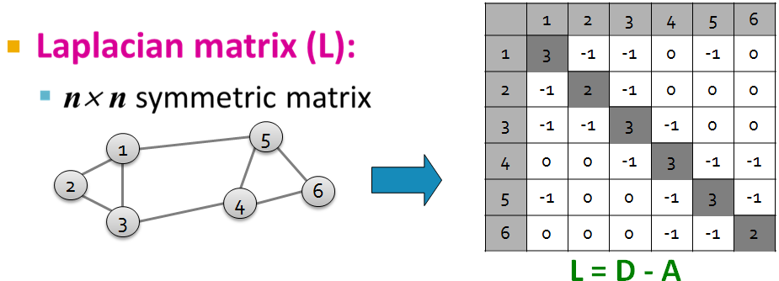
Matrix Representations
How can we use (L) to find good partitions of our graph?
What are the eigenvalues and eigenvectors of (L)?
We know: L . x = λ . x

Slide 29
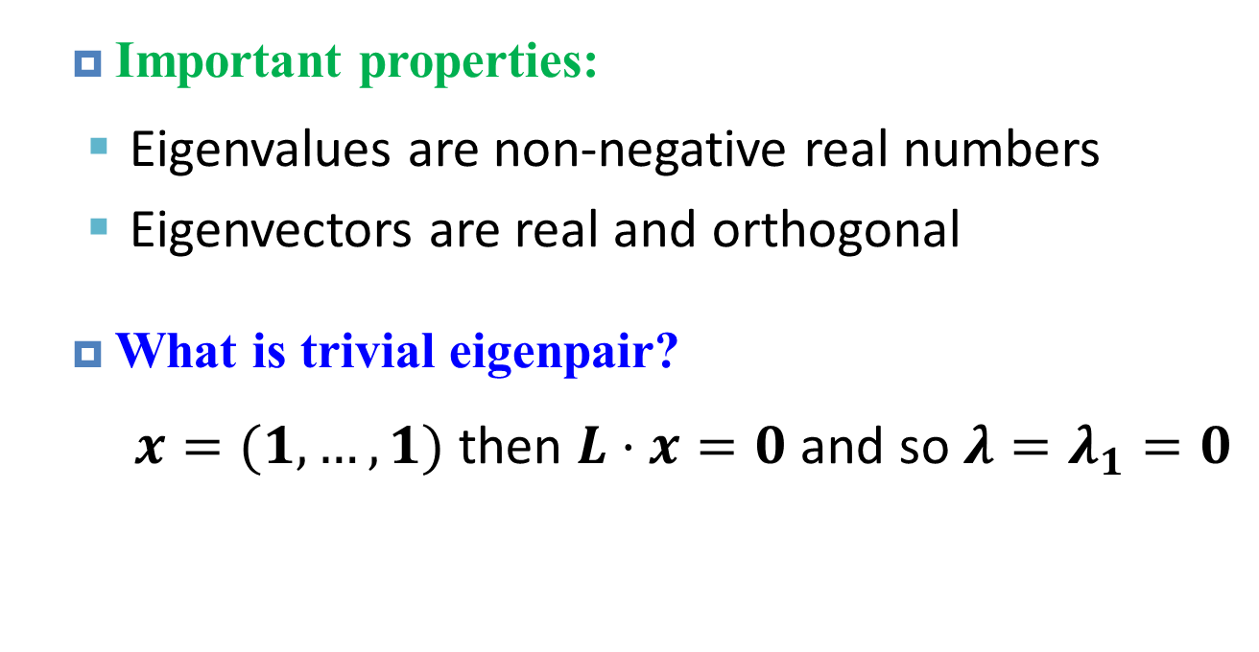
Spectrum of Laplacian Matrix (L)
The Laplacian Matrix (L) has:
Eigenvalues where
Eigenvectors
Important properties:
Eigenvalues are non-negative real numbers
Eigenvectors are real and orthogonal
What is trivial eigenpair?
$x=(1,…,1)$ then $L⋅x=0$ and so ${λ=λ}_{1}=0$
29

Slide 30
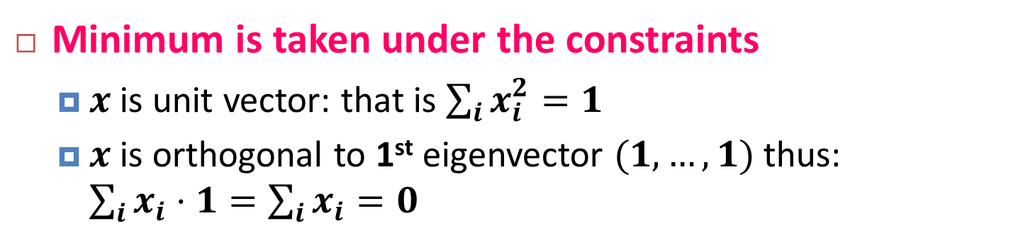
Best Eigenvector for partitioning
Second Eigenvector
Best eigenvector that represents best quality of graph partitioning.
Let’s check the components of through
Fact: For symmetric matrix (L):
Minimum is taken under the constraints
$x$ is unit vector: that is $\sum_{i}{x_{i}^{2}=1}$
$x$ is orthogonal to 1st eigenvector $(1,…,1)$thus: $\sum_{i}{x_{i}⋅1}=\sum_{i}{x_{i}}=0$

Slide 31
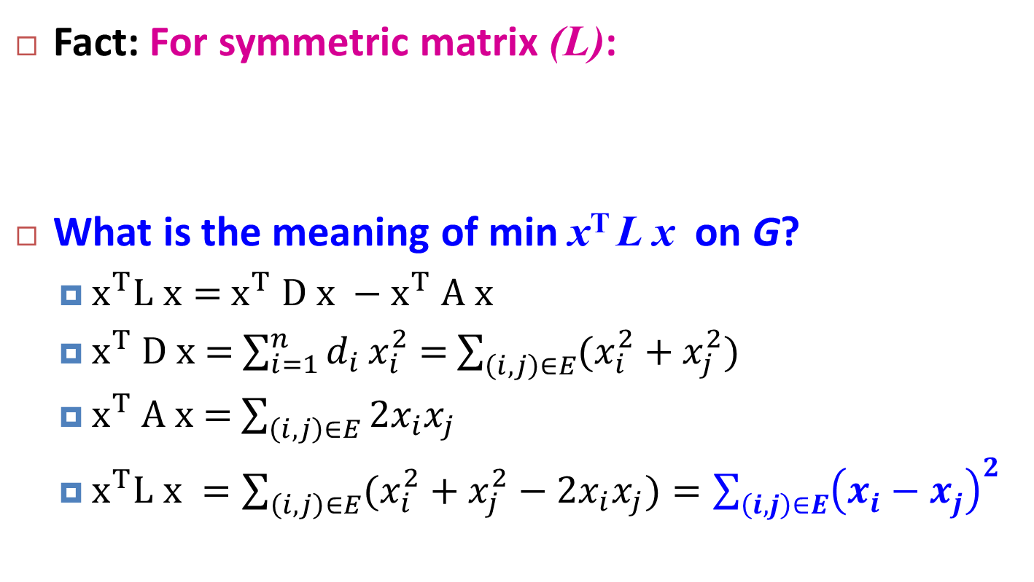
λ2 as optimization problem
Details!
Fact: For symmetric matrix (L):
What is the meaning of min x^{T} L x on G?
$x^{T}L x=$ $x^{T} D x −x^{T} A x$
$x^{T} D x$ = $\sum_{i=1}^{n}{d_{i}}x_{i}^{2}$ = $\sum_{\left(i,j\right)∈E}{(x_{i}^{2}+x_{j}^{2})}$
$x^{T} A x$= $\sum_{\left(i,j\right)∈E}{2x_{i}x_{j}}$
$x^{T}L x =\sum_{\left(i,j\right)∈E}{(x_{i}^{2}+x_{j}^{2}−2x_{i}x_{j})}=\sum_{\left(i,j\right)∈E}{{\left(x_{i}^{}−x_{j}^{}\right)}^{2}}$
Remember : L = D - A

Slide 32
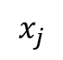
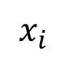
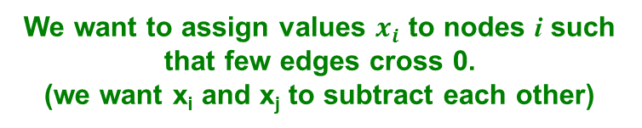
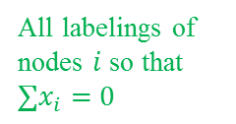
λ2 as optimization problem
All labelings of nodes $i$ so that $∑x_{i}=0$
We want to assign values $x_{i}$ to nodes i such that few edges cross 0. (we want x_{i} and x_{j} to subtract each other)
i
j
x
$$x_{i}$$
0
$$x_{j}$$
Balance to minimize

Slide 33
Spectral Partitioning Algorithm: Example
1) Pre-processing:
Build Laplacian matrix L of the graph
2) Decomposition:
Find eigenvalues λ and eigenvectors x of the matrix L
Map vertices to corresponding components of X₂
 | 1 | 2 | 3 | 4 | 5 | 6
1 | 3 | -1 | -1 | 0 | -1 | 0
2 | -1 | 2 | -1 | 0 | 0 | 0
3 | -1 | -1 | 3 | -1 | 0 | 0
4 | 0 | 0 | -1 | 3 | -1 | -1
5 | -1 | 0 | 0 | -1 | 3 | -1
6 | 0 | 0 | 0 | -1 | -1 | 2
0.0
0.4
0.3
-0.5
-0.2
-0.4
-0.5
1.0
0.4
0.6
0.4
-0.4
0.4
0.0
λ=
3.0
X =
0.4
0.3
0.1
0.6
-0.4
0.5
3.0
0.4
-0.3
0.1
0.6
0.4
-0.5
4.0
0.4
-0.3
-0.5
-0.2
0.4
0.5
5.0
0.4
-0.6
0.4
-0.4
-0.4
0.0
1
0.3
2
0.6
3
0.3
How do we now find the clusters?
4
-0.3
5
-0.3
6
-0.6
Notes:
How to find normalized eigenvector?
The easiest way to normalize the eigenvector is to divide by its length.
Length of the vector X: $\left|X\right|$= $\sqrt{{x_{1}}^{2}+{x_{2}}^{2}+{x_{3}}^{2}+{x_{4}}^{2}+ .. +{x_{n}}^{2}}$ ,
Therefore the each value of the eigenvector will be ${x_{i}}^{′}= \frac{x_{i}}{\left|X\right|}$ and the normalized eigenvector length of $X^{′}:$ $\left|X^{′}\right|$= $\sqrt{{{x′}_{1}}^{2}+{{x′}_{2}}^{2}+ .. +{{x′}_{n}}^{2}}$ , which equals to $\sum_{i}{{x_{i}}^{2}}$
So the length of the normalized vector is one.
http://www.ncl.ac.uk/students/mathsaid/resources/academic/matrix_eigenvector.htm

Slide 34
Spectral Partitioning Algorithm: Example
3) Grouping:
Sort components of reduced 1-dimensional vector
Identify clusters by splitting the sorted vector in two
How to choose a splitting point?
Naïve approaches:
Split at 0 or median value
Split at 0:
Cluster A: Positive points
Cluster B: Negative points
1
0.3
A
B
2
0.6
3
0.3
4
-0.3
1
0.3
4
-0.3
5
-0.3
2
0.6
5
-0.3
6
-0.6
3
0.3
6
-0.6

Slide 35
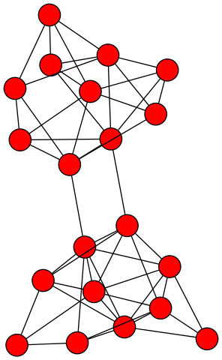
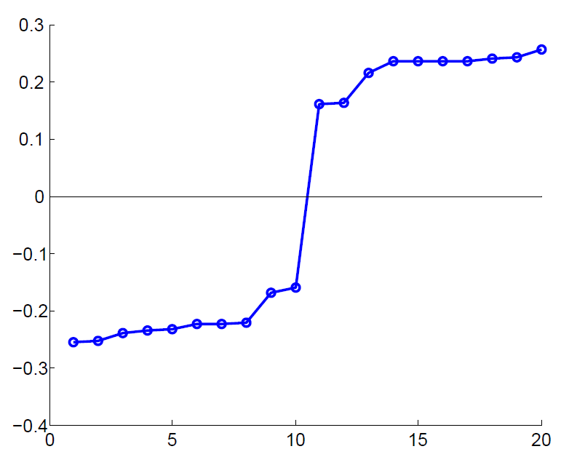
Example: Spectral Partitioning
Value of x₂
Rank in x₂

Slide 36
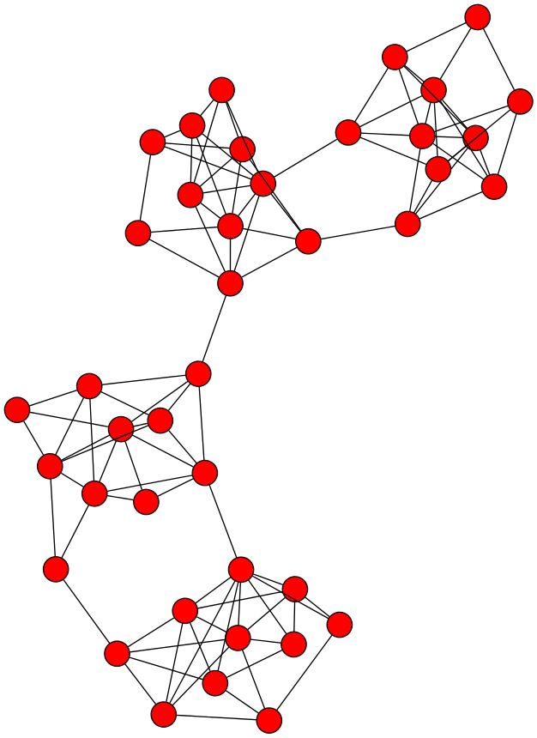
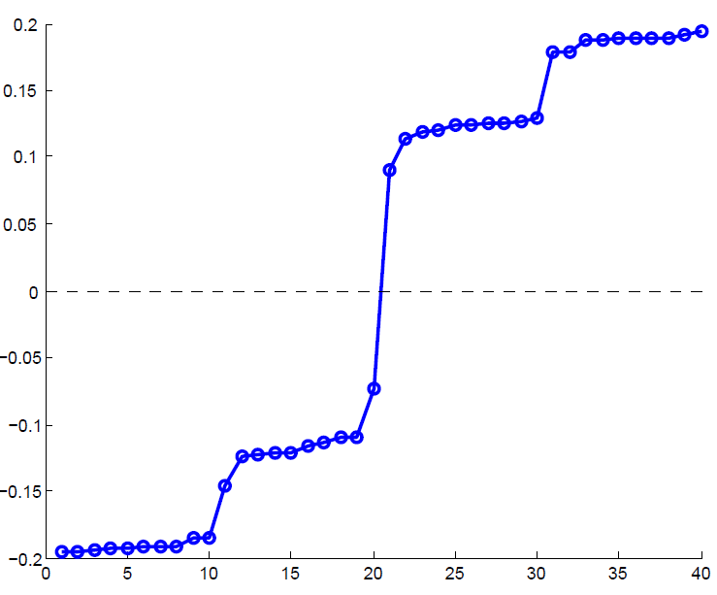
Example: Spectral Partitioning
Components of x₂
Value of x₂
Rank in x₂

Slide 37
k-Way Spectral Clustering
How do we partition a graph into k clusters?
Two basic approaches:
Recursive bi-partitioning [Hagen et al., ’92]
Recursively apply bi-partitioning algorithm in a hierarchical divisive manner
Disadvantages: Inefficient
Cluster multiple eigenvectors [Shi-Malik, ’00]
Build a reduced space from multiple eigenvectors
Commonly used in recent papers
A preferable approach

Slide 38
Non-overlapping Communities
Nodes
Nodes
Network
Adjacency matrix
Notes:
So far, we have concentrated on clustering a social graph into several non-overlapping communities.
The assumption of this task is that the members within a community are more likely to know each other but the members from two different communities are unlikely to know each other.
The left figure in this slide shows

Slide 39
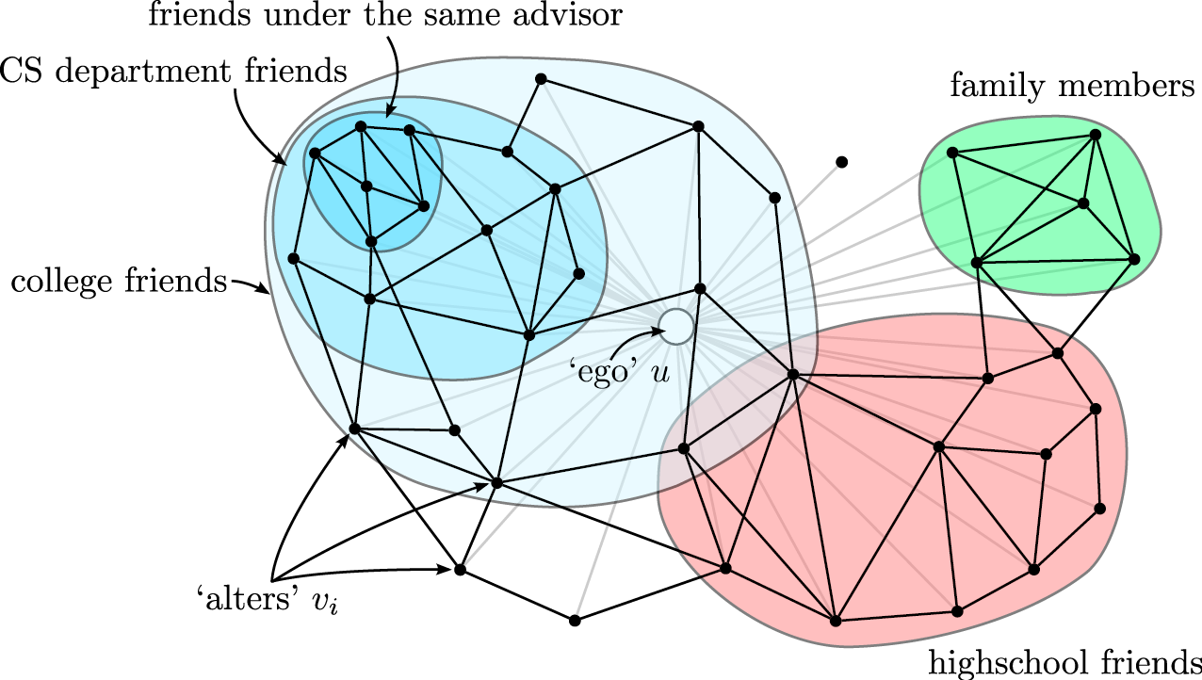
Non-overlapping vs Overlapping
Notes:
However, this assumption holds true only at circumstance that a member can only belong to one community, that is communities are non-overlapping.
For example, communities of school departments are non-overlapping, because one student can only belong to one department.
But there are some communities actually overlap with each other, like the community of college friends and the community of highschool friends.

Slide 40
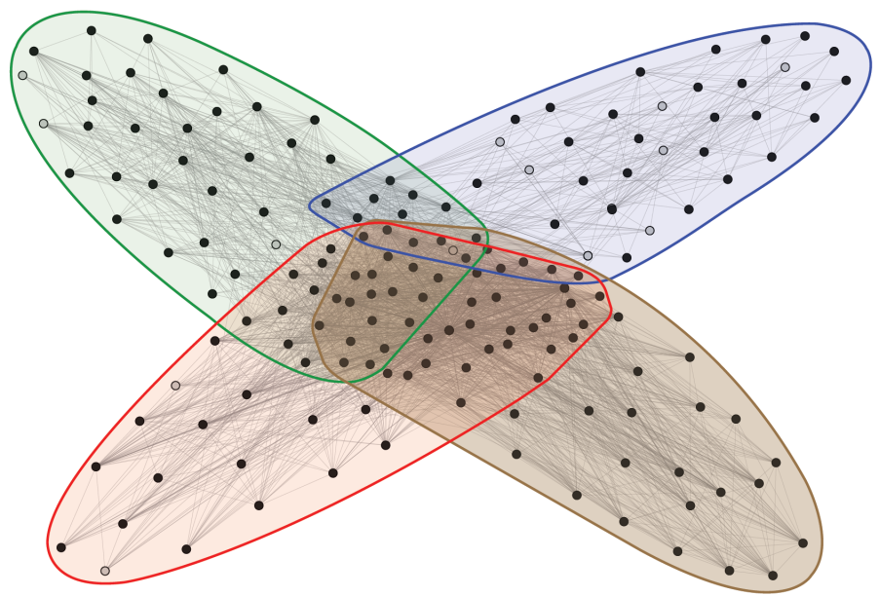
Facebook Network
Social communities
High school
Summer internship
Stanford (Basketball)
Stanford (Squash)
Nodes: Facebook Users
Edges: Friendships
40
Notes:
This kind of communities can be commonly found in the facebook networks.
So detecting them is also an interesting topic, but differs a lot from the previous introduced methods.

Slide 41
Appendix

Slide 42
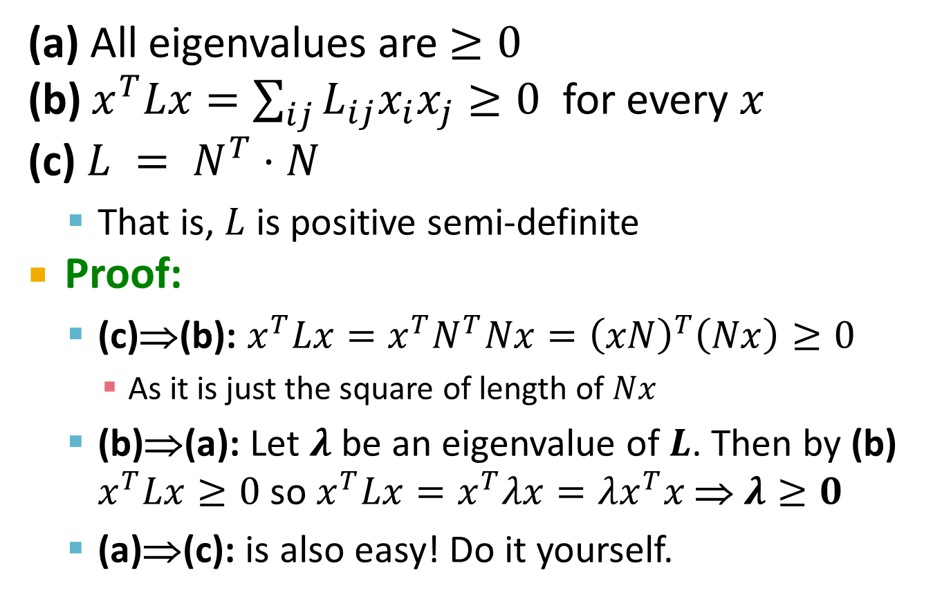
Facts about the Laplacian L
Details!
(a) All eigenvalues are $≥0$
(b) $x^{T}Lx=\sum_{ij}{L_{ij}x_{i}x_{j}}≥0$ for every $x$
(c) $L = N^{T}⋅N$
That is, $L$ is positive semi-definite
Proof:
(c)⇒(b): $x^{T}Lx=x^{T}N^{T}Nx={\left(xN\right)}^{T}\left(Nx\right)≥0$
As it is just the square of length of $Nx$
(b)⇒(a): Let $λ$ be an eigenvalue of $L$. Then by (b) $x^{T}Lx≥0$ so $x^{T}Lx=x^{T}λx=λx^{T}x$ ⇒ $λ≥0$
(a)⇒(c): is also easy! Do it yourself.

Slide 43
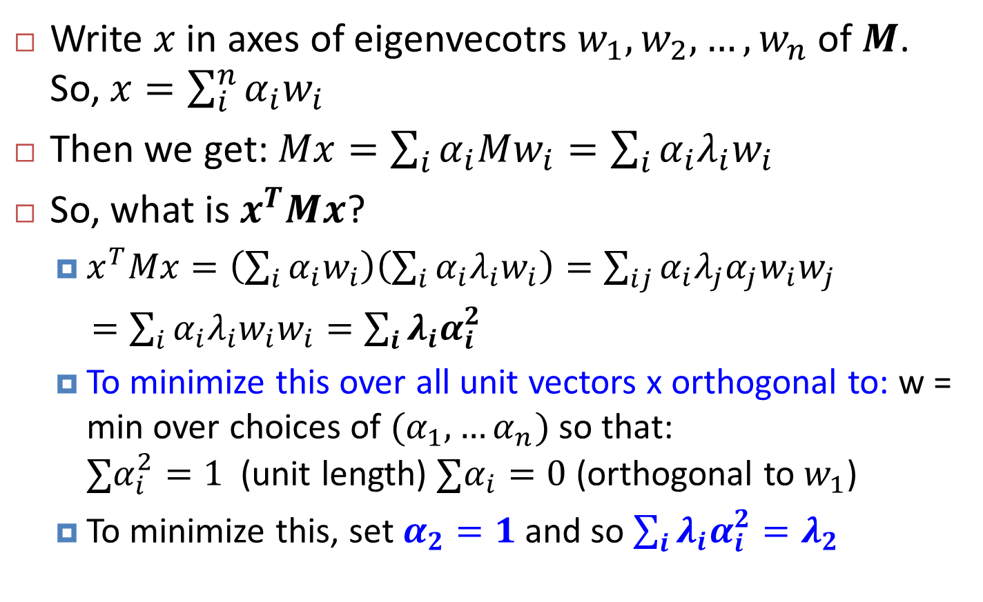
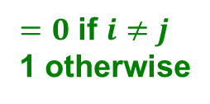

Proof:
Details!
Write $x$ in axes of eigenvecotrs $w_{1},w_{2}, …, w_{n}$ of $M$. So, $x=\sum_{i}^{n}{α_{i}w_{i}}$
Then we get: $Mx=\sum_{i}{α_{i}Mw_{i}}=\sum_{i}{α_{i}λ_{i}w_{i}}$
So, what is $x^{T}Mx$?
$x^{T}Mx=\left(\sum_{i}{α_{i}w_{i}}\right)\left(\sum_{i}{α_{i}λ_{i}w_{i}}\right)=\sum_{ij}{α_{i}λ_{j}α_{j}w_{i}w_{j}}$
$=\sum_{i}{α_{i}λ_{i}w_{i}w_{i}}=\sum_{i}{λ_{i}α_{i}^{2}}$
To minimize this over all unit vectors x orthogonal to: w = min over choices of $(α_{1}, …α_{n})$ so that: $∑α_{i}^{2}=1$ (unit length) $∑α_{i}=0$ (orthogonal to $w_{1}$)
To minimize this, set $α_{2}=1$ and so $\sum_{i}{λ_{i}α_{i}^{2}=λ_{2}}$
$=0$ if $i≠j$
1 otherwise
$$λ_{i}w_{i}$$

